Slide 1
Introduction to The Data Science Pipeline
BWSI: Medlytics July 6th 2020
Notes:
1
1
Check distro statement before using:
DISTRIBUTION STATEMENT A. Approved for pubic release: distribution is unlimited.
This material is based upon work supported under Air Force Contract No. FA8721-05-C-0002 and/or FA8702-15-D-0001. Any opinions, findings, conclusions or recommendations expressed in this material are those of the author(s) and do not necessarily reflect the views of the U.S. Air Force.
© 2020 Massachusetts Institute of Technology.
Delivered to the U.S. Government with Unlimited Rights, as defined in DFARS Part 252.227-7013 or 7014 (Feb 2014). Notwithstanding any copyright notice, U.S. Government rights in this work are defined by DFARS 252.227-7013 or DFARS 252.227-7014 as detailed above. Use of this work other than as specifically authorized by the U.S. Government may violate any copyrights that exist in this work.

Slide 2
Example: Starting with a Question
Most people know that exercise provides health benefits, but few people actually exercise. Perhaps more people could be motivated to exercise if its benefits were better understood.
Questions
What groups of people are more likely to exercise?
To what degree does exercise increase life span?
Does exercise help depression?
Are you more alert after exercise?
Is one type of exercise better than others?

Slide 3
The Data Science Pipeline
Question
What data do you need?
Understand and Analyze your data
Report
Select your methods
Do you have the data?
Design experiment/collect data
No
Analyze
Yes
Clean and transform the data
Visualize

Slide 4
The OSEMN Data Science Pipeline
Obtaining data
Knowledge flows from observations
Scrubbing / cleaning data
Missing entries, etc…
Exploring / visualizing data
WARNING: independent test data required!
Modeling data
Provides predictive power (This is the hypothesis!)
iNterpreting data
Communicate your findings to a broader audience
Medlytics course will walk you through several examples of this pipeline

Slide 5

Analyze that Data!
When you’re wondering what to do with your data. Just remember….

Slide 6
Outline
Introduction
Formulating a question
Getting the right data
Planning your analysis

Slide 7
Scientific Epistemology
• An hypothesis can only be falsified. It can never be proved true. • An hypothesis must be falsifiable to be of any epistemic value.
Pre-observational Work
Belief: “All swans are white”
Prediction: “If all swans are white, then you should never find any swans of a different color”
Proposed test: “Observe many swans”

Slide 8
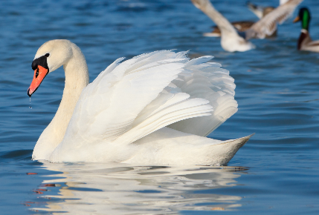
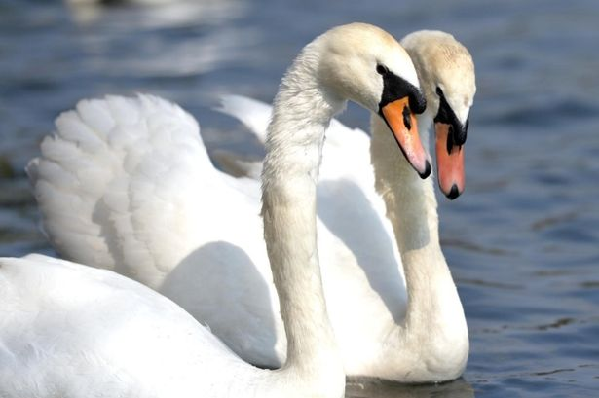
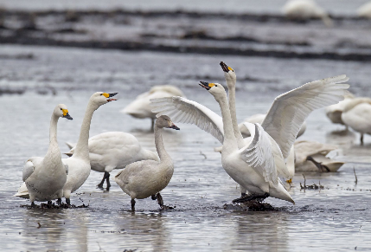
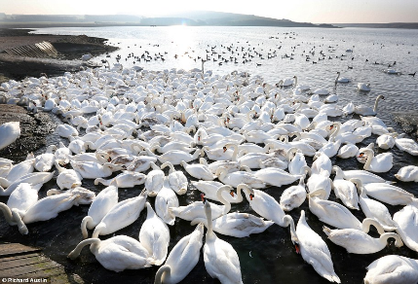
Scientific Epistemology
• An hypothesis can only be falsified. It can never be proved true. • An hypothesis must be falsifiable to be of any epistemic value.
Pre-observational Work
Observational Data
Belief: “All swans are white”
Prediction: “If all swans are white, then you should never find any swans of a different color”
Proposed test: “Observe many swans”

Slide 9

Scientific Epistemology
• An hypothesis can only be falsified. It can never be proved true. • An hypothesis must be falsifiable to be of any epistemic value.
Pre-observational Work
Observational Data
Belief: “All swans are white”
Prediction: “If all swans are white, then you should never find any swans of a different color”
Proposed test: “Observe many swans”
Only this observation yielded new knowledge

Slide 10
Scientific Epistemology
• An hypothesis can only be falsified. It can never be proved true. • An hypothesis must be falsifiable to be of any epistemic value.
Pre-observational Work
Observational Data
Belief: “All swans are white”
Prediction: “If all swans are white, then you should never find any swans of a different color”
Proposed test: “Observe many swans”
Only this observation yielded new knowledge
WARNING:
Machine learning builds a model from observational data. It is critical to have independent test data, otherwise the model is epistemically useless.

Slide 11
Brainstorming a Scientific Question
Work in groups to generate some questions.
You will be assigned to groups in breakout rooms
[5 min] Brainstorm a scientific question you would like to ask
All brainstorming ideas are good, so write them down!
[5 min] Focus your idea: be sure to identify your criteria!
Example criteria:
Likely impact of answering the question
Personal interest in subject matter
Cost of obtaining data to answer question
[2 min] Record primary question and secondary ideas on Google Document

Slide 12
Outline
Introduction
Formulating a question
Getting the right data
Planning your analysis

Slide 13
Example Data Requirements
Example Question:
What is the effect of exercise (in minutes/day) on blood glucose levels?
Primary Data Requirements
Exercise
Glucose levels
Fasting information or time since they last ate?
Possible Confounders (must also be measured)
Sex
Age
Ethnicity

Slide 14
Identifying Data Requirements
[5 min] Identify the data required to answer your group’s question
List out all the data requirements
Primary data
Possible confounders
Any other relevant details
Cost of obtaining data
Is number of possible confounders practicable
Record everything in the Google Document

Slide 15






Available Datasets

Slide 16
Dataset Literature Review
[20 min] Become an expert in a dataset
Return to breakout room groups
Group mission: become an expert in your dataset!
Prepare a brief (1 to 2 lines) description of the dataset
Make a list of the pros and cons of the dataset
Include any miscellaneous information
Prepare a summary of the dataset in the Google Document
Present to the class
Group Datasets (links posted in chat)
NHANES
UK Biobank
DHS Program
BRFSS

Slide 17
Dataset Descriptions

Slide 18
Outline
Introduction
Formulating a question
Getting the right data
Planning your analysis

Slide 19
Answering Your Question with an Existing Dataset
[15 min] Evaluate which (if any) dataset might answer your question
Back to breakout room groups
Go around the group – each member tell the others why you think your dataset is a good candidate or not
Discuss and evaluate the datasets
On a large post-it provide the following:
Question that you want to investigate
The dataset that you have chosen for your investigation
The rationale for your choice
[3 min] Each team will give a short presentation

Slide 20


